Slide 1


ME-518
ASSIGNMENT-3
BI-PEDAL SYSTEM

Slide 2

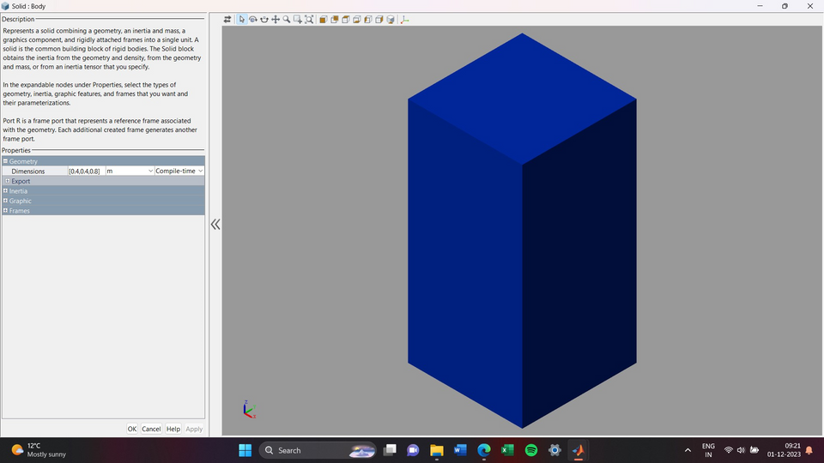
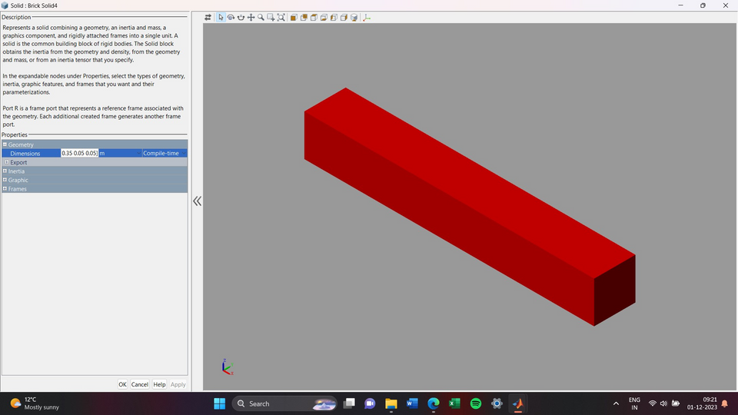
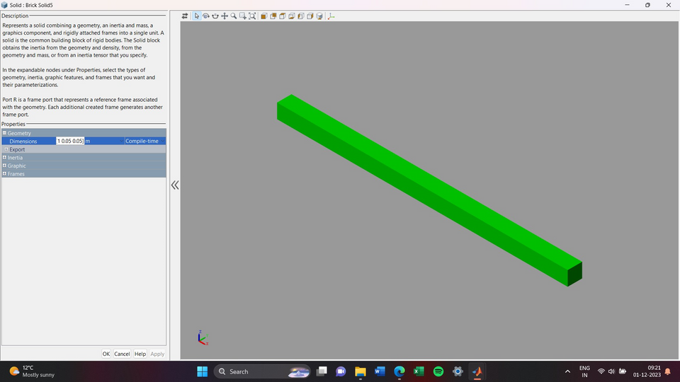
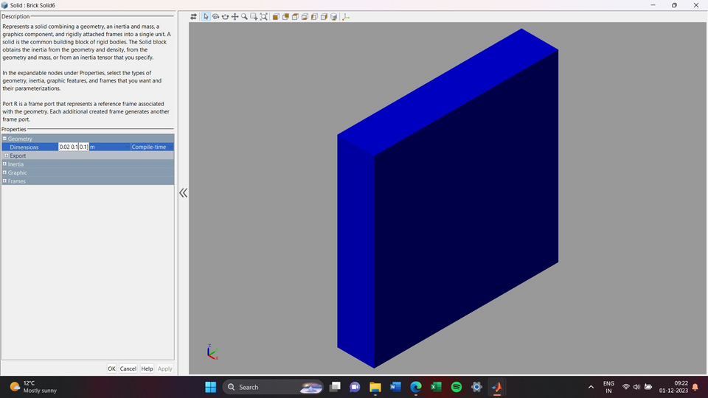
ASSUMPTIONS
Body [0.4x0.4x0.8]
Upper Leg [0.35x0.35x0.5]
Lower Leg [1x0.05x0.05]
Foot [0.02x0.1x0.1]

Slide 3
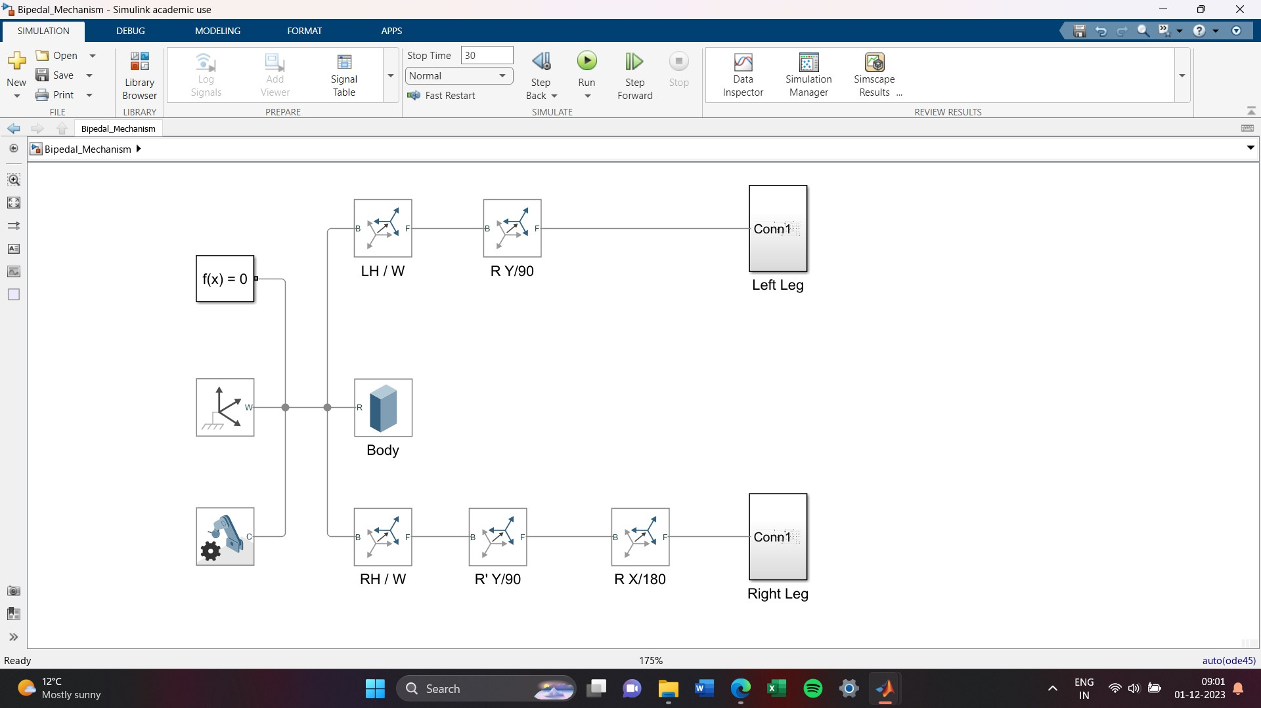
MODELLING

Slide 4
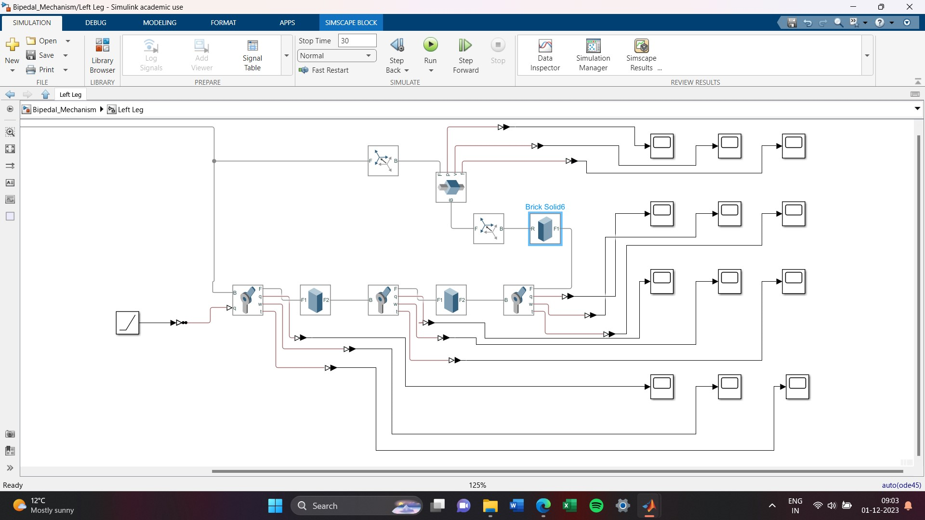
LEG SUBSYSTEM
Courtesy - Slider_crank.slx (Classroom)

Slide 5
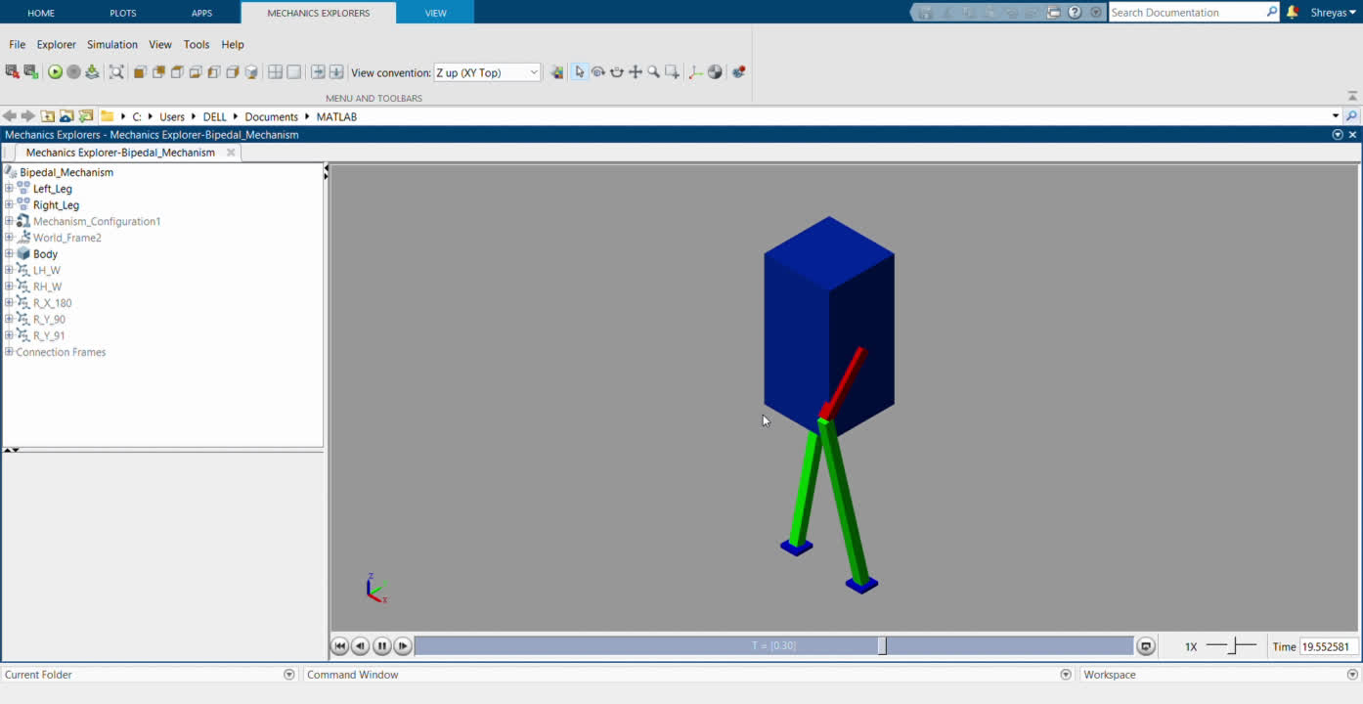
ANIMATION

Slide 6
LEARNING OUTCOME
This assignment helped me to learn model a mechanical mechanism on matlab and provide exposure to the simscape and multibody simscape libraries in the simulink environment.Using the files available on the classroom I animated the simulation created.
DRAWBACS/DIFFICULTIES
I couldn’t figure out how to restrict the upper leg from compeleting a full revolution, hence the deviation of my machine from an actual bi-pedal mechanism.

Slide 7
REFERENCES
Modeling and Simulation of Walking Robots : https://www.youtube.com/watch?v=qMx1nbi5lUs&list=PLn8PRpmsu08rdL7jwgrQjewdFXxDHbyIV&index=3&ab_channel=MATLAB
How to design Robots using MATLAB 2021 | SimScape Toolbox | Robotics System Toolbox : https://www.youtube.com/watch?v=_8YCc3pJDPI&ab_channel=LearningOrbis
Slider_crank.slx : Classroom file

